Slide 1





ISCG8050 Machine Learning for Intelligent Data and Information Processing
Week 2 - A
Sources: Hands-On Machine Learning with Scikit-Learn, Keras, and TensorFlow by Aurélien Géron

Slide 2
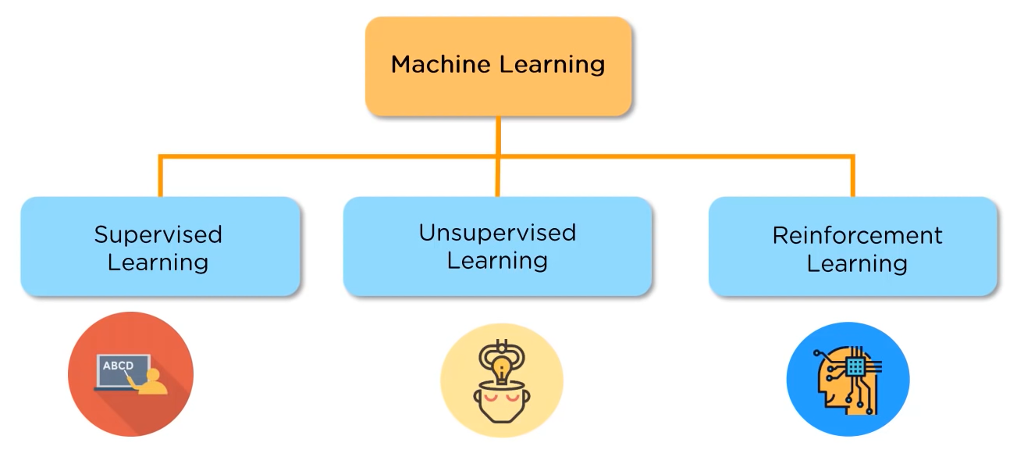
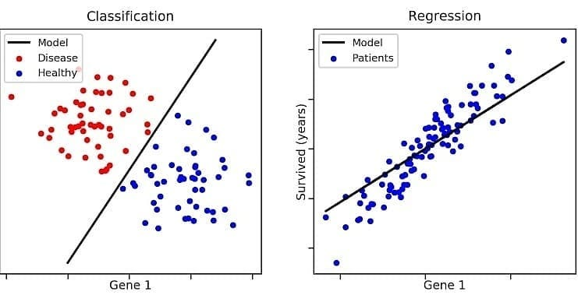
Review
Types of Machine Learning
Supervised Learning
Unsupervised Learning
Reinforcement Learning
Supervised Learning
Regression (predicting values)
Linear Regression
Polynomial Regression
Classification (predicting classes)

Slide 3
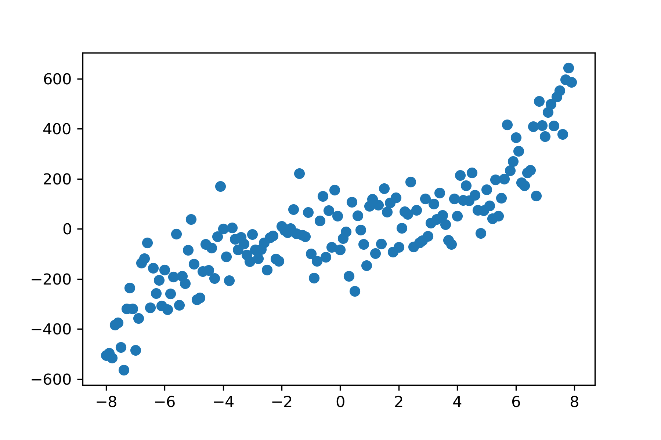
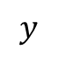
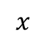
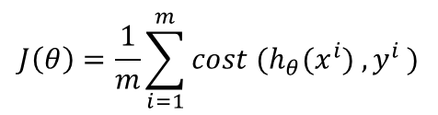
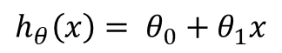
Review
Terminology
Features
Target
Hypothesis
Cost function
Training Set
$$x$$
Learning Algorithm
Size of house
h
Estimated price
$$y$$
$$h_{θ}\left(x\right)= θ_{0}+θ_{1}x$$
$$J\left(θ\right)=\frac{1}{m}\sum_{i=1}^{m}{{cost (h}_{θ}(x^{i}) {, y}^{i})}$$

Slide 4
Review
Machine Learning Challenges
Bad Data:
Not enough quantity of training data
Nonrepresentative and bias training data
Poor-Quality Data
Irrelevant Features or data
Bad Algorithm:
Overfitting the Training Data
Underfitting the Training Data
Training Set and Testing Set
To know how well a model will generalize to new cases we split the data into two sets: the training set and the test set.
The error rate on new cases from the test set is used to estimate the performance of the model.
The test set must be as representative as possible of the data you expect to use in production

Slide 5
Spot Quiz
Problem: Creating a commercial dashboard
Description: develop a dashboard that displays various business metrics like sales, revenue, user engagement, etc., Sourced from multiple databases and API.
Machine learning might be useful for adding advanced features to your dashboard, like predictive analytics or anomaly detection, but the core functionality of aggregating and displaying data can be efficiently handled without machine learning. In this context, machine learning would be an enhancement rather than a necessity.

Slide 6
Spot Quiz
Problem : Checking Text for Spelling Errors
Description: Scan a text document to identify and correct spelling errors.
While basic spelling errors can be checked using a dictionary look-up method, advanced contextual spelling and grammar checking might benefit from machine learning. However, for a simple spell-check, traditional methods suffice.

Slide 7
Spot Quiz
Problem: Detecting Parking Spaces from Aerial Images
Description: Given aerial images of parking lots, the task is to identify and count the number of available parking spaces.
If the images are consistent in terms of lighting, angle, and quality, and the parking spaces are clearly marked, then traditional programming techniques might be sufficient. However, for more complex, real-world scenarios where these conditions vary, machine learning would likely be the more effective approach.

Slide 8
Spot Quiz
Problem: Weather Forecasting
Description: Predict meteorological conditions such as temperature, precipitation, wind speed, and humidity for a specific location and time.
Traditional methods for weather forecasting often rely on physical models based on the laws of physics and atmospheric science, such as the Navier-Stokes equations.
Machine learning methods like neural networks are increasingly being explored for weather forecasting. These methods can capture complex, non-linear relationships in data and can integrate information from various sources more easily than traditional models. They're especially useful for short-term predictions or for improving the accuracy of longer-term forecasts made using traditional methods.

Slide 9
Class Activity
Class Activity: Predict Burnt Calories using Machine Learning
Objective: To develop a machine learning model that predicts the number of burnt calories based on various features like Age, Height, Weight, Duration, Heart_Rate, and Body_Temp.
Steps:
Import Libraries
Read CSV file
Evaluate the dataset
Prepare Data for Training
Train-Test Split
Create and Train the Model
Evaluate the model

Slide 10
Outline
Classification Models:
Logistic Regression
Sigmoid
Decision Boundary
Multiclass Classification
Support Vector Machine
Linear SVM
Nonlinear SVM

Slide 11
Classification
Classification Problems
Email -> spam/not spam?
Online transactions -> fraudulent?
Tumor -> Malignant/benign
Variable in these problems is Y
Y is either 0 or 1
0 = negative class (absence of something)
1 = positive class (presence of something)
Binary Class Problems
0: “Negative Class” (e.g., benign tumor)
1: “Positive Class” (e.g., malignant tumor)

Slide 12
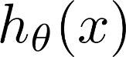
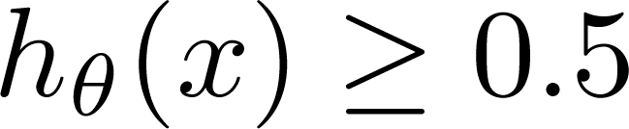
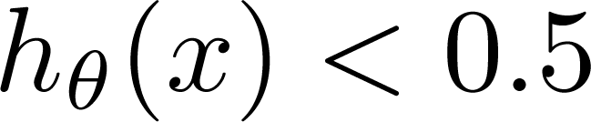
Binary Classification Problems
We could use linear regression
Then threshold the classifier output (i.e. anything over some value is yes, else no)
(Yes) 1
Malignant?
(No) 0
Tumor Size
Tumor Size
Threshold classifier output at 0.5:
If , predict “y = 1”
If , predict “y = 0”

Slide 13
Why Not Linear Regression?
In the provided Tumor classification, we can see linear regression does a reasonable job of assigning the data points into one of two classes
But what if we had a single Yes with a very large tumour
Regression line fitted to data changes and
This would lead to classifying all the existing YESes as NOs
(Yes) 1
Malignant?
(No) 0
Tumor Size
Tumor Size

Slide 14
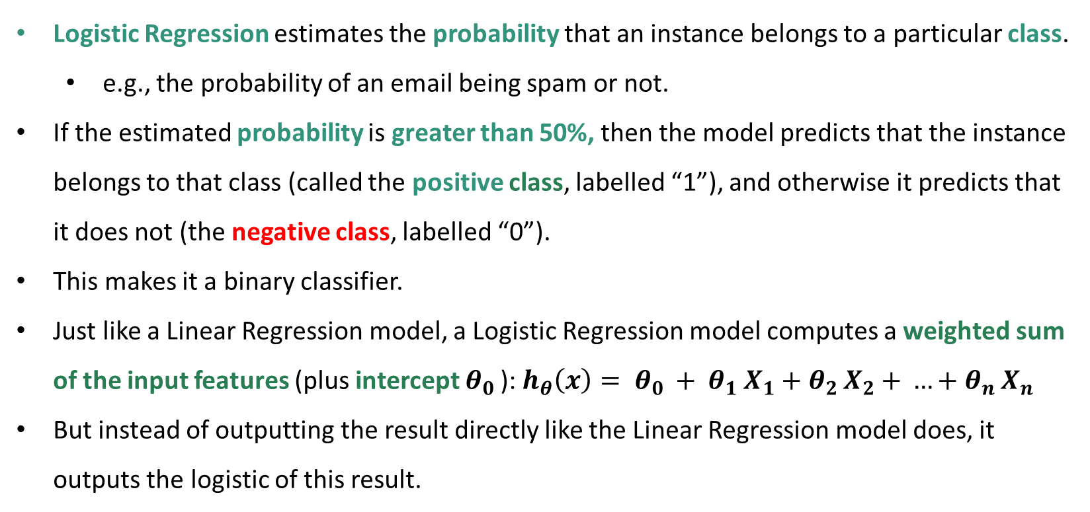
Logistic Regression
Logistic Regression estimates the probability that an instance belongs to a particular class.
e.g., the probability of an email being spam or not.
If the estimated probability is greater than 50%, then the model predicts that the instance belongs to that class (called the positive class, labelled “1”), and otherwise it predicts that it does not (the negative class, labelled “0”).
This makes it a binary classifier.
Just like a Linear Regression model, a Logistic Regression model computes a weighted sum of the input features (plus intercept $θ_{0 }$): $h_{θ}\left(x\right)= θ_{0 }+ θ_{1 }X_{1}$ $+ θ_{2 }X_{2}$ $+ …+θ_{n }X_{n}$
But instead of outputting the result directly like the Linear Regression model does, it outputs the logistic of this result.

Slide 15
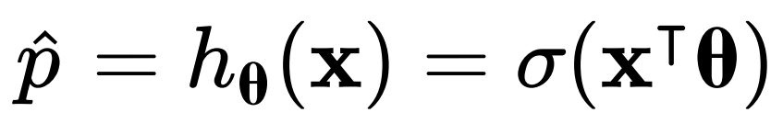
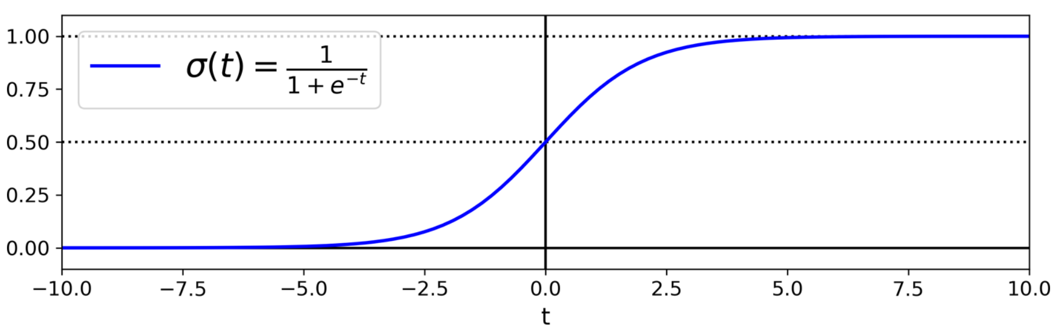
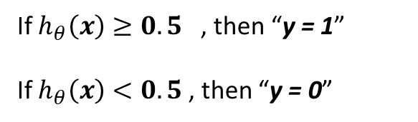
Logistic Regression
The logistic σ is a sigmoid function that outputs a number between 0 and 1.
When the Logistic Regression model has estimated the probability $h_{θ}(x)$ that an instance $x$ belongs to the positive class, then it can make its prediction $y$.
If $h_{θ}\left(x\right)≥0.5$ , then “y = 1”
If $h_{θ}\left(x\right)<0.5$ , then “y = 0”

Slide 16
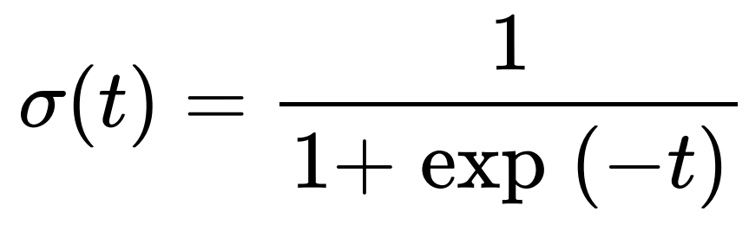
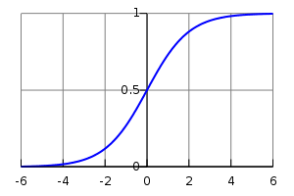
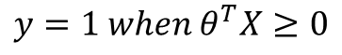
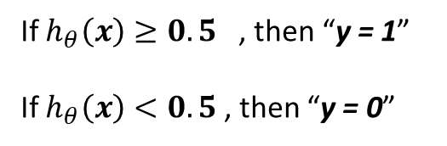
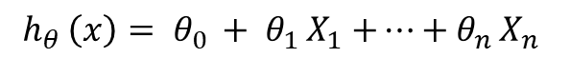
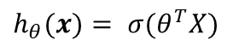
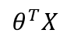
Logistic Regression Decision Boundaries
${h_{θ }\left(x\right)= θ}_{0 }+ θ_{1 }X_{1}$ $+…+θ_{n }X_{n}$
$$y=1 when θ^{T}X≥0$$
If $h_{θ}\left(x\right)≥0.5$ , then “y = 1”
If $h_{θ}\left(x\right)<0.5$ , then “y = 0”
$${h_{θ}(x)= σ(θ}^{T}X)$$
Hypothesis predicts y = 1 when θ^{T} x >= 0
Then the hypothesis predicts y = 0 when θ^{T} x <= 0
$$θ^{T}X$$

Slide 17
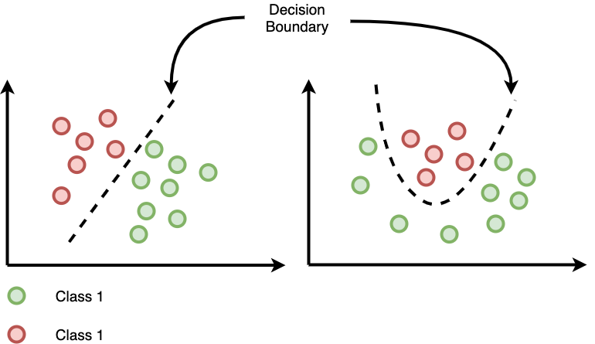
Logistic Regression What Are Decision Boundaries?
Definition: A hypersurface that separates different classes in a classification problem.
Types:
Linear: Straight lines, planes, or hyperplanes (e.g., Logistic Regression, Linear SVM)
Non-Linear: Curved surfaces (e.g., Decision Trees, Kernel SVM)
Importance: Help us understand how a machine learning algorithm categorizes data points and assess its complexity.
Limitations
Visualization: Useful but often limited to lower dimensions for clarity.
Limitations: Hard to visualize in high dimensions and may not capture all details of the model.

Slide 18
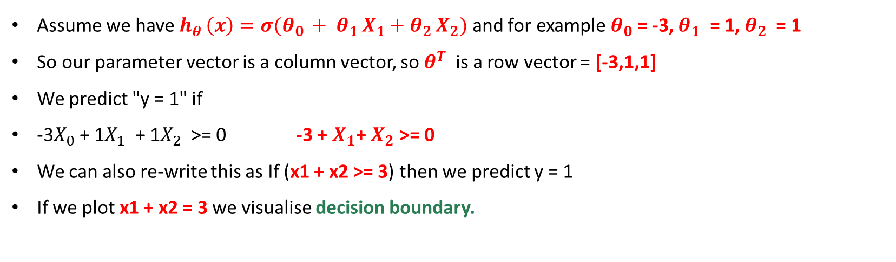
Logistic Regression Decision Boundaries Example
Assume we have ${h_{θ }\left(x\right)=σ(θ}_{0 }+ θ_{1 }X_{1}+θ_{2 }X_{2})$ and for example $θ_{0}$ = -3, $θ_{1}$ = 1, $θ_{2}$ = 1
So our parameter vector is a column vector, so $θ^{T}$ is a row vector = [-3,1,1]
We predict "y = 1" if
-3$X_{0}$ + 1$X_{1}$ + 1$X_{2}$ >= 0 -3 + $X_{1}$+ $X_{2}$ >= 0
We can also re-write this as If (x1 + x2 >= 3) then we predict y = 1
If we plot x1 + x2 = 3 we visualise decision boundary.
x₂
x₂
3
3
2
Blue = false
Magenta = true
Line = decision boundary
2
Decision Boundary
1
1
1
2
3
x₁
1
2
3
x₁

Slide 19
Logistic Regression Logistic Regression in Python
Let’s Try Logistic Regression in Python

Slide 20
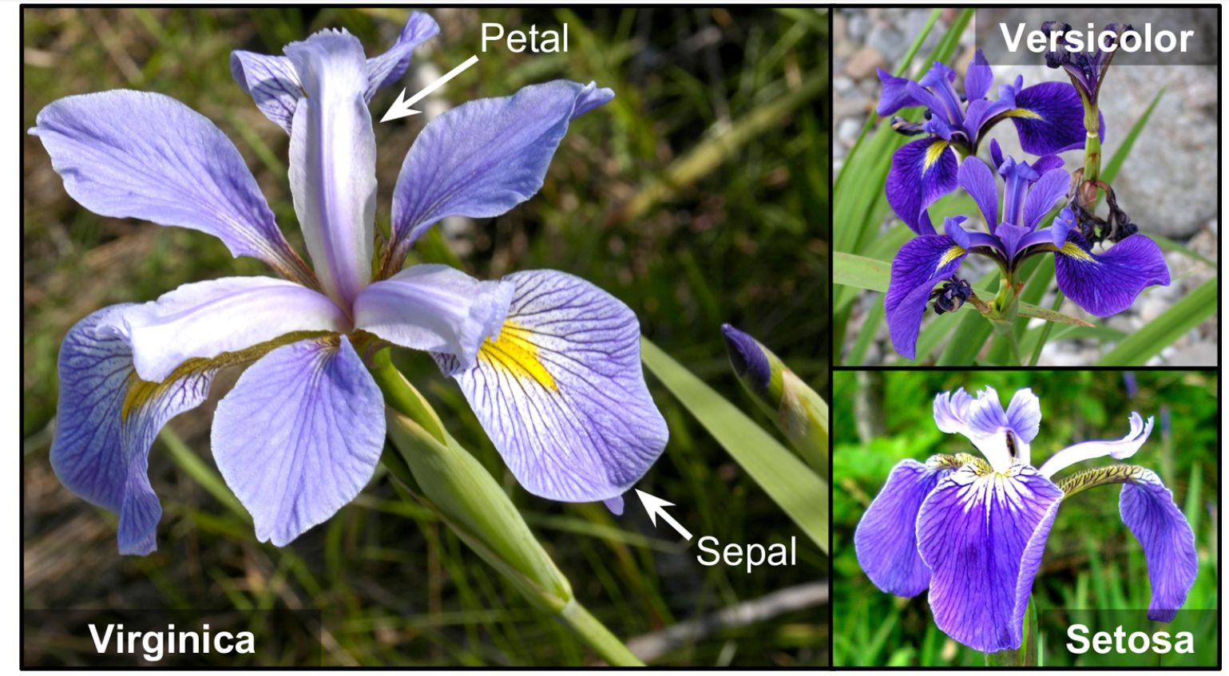
Logistic Regression Logistic Regression in Python
Let’s use the iris dataset to illustrate Logistic Regression.
Iris dataset is a famous dataset that contains the sepal and petal length and width of 150 iris flowers of three different species: Iris setosa, Iris versicolor, and Iris virginica.

Slide 21
Logistic Regression Logistic Regression in Python
Let’s build a classifier to detect the Iris virginica type based only on the petal width feature.
First load the data:
Set X with the petal width.
Set Y = 1 if Iris virginica, else 0
Now train a Logistic Regression model:
import numpy as np
import matplotlib.pyplot as plt
from sklearn import datasets
iris = datasets.load_iris()
list(iris.keys())
X = iris["data"][:, 3:] # petal width
y = (iris["target"] == 2).astype(np.int64) # 1 if Iris virginica, else 0
from sklearn.linear_model import LogisticRegression
log_reg = LogisticRegression()
log_reg.fit(X, y)

Slide 22
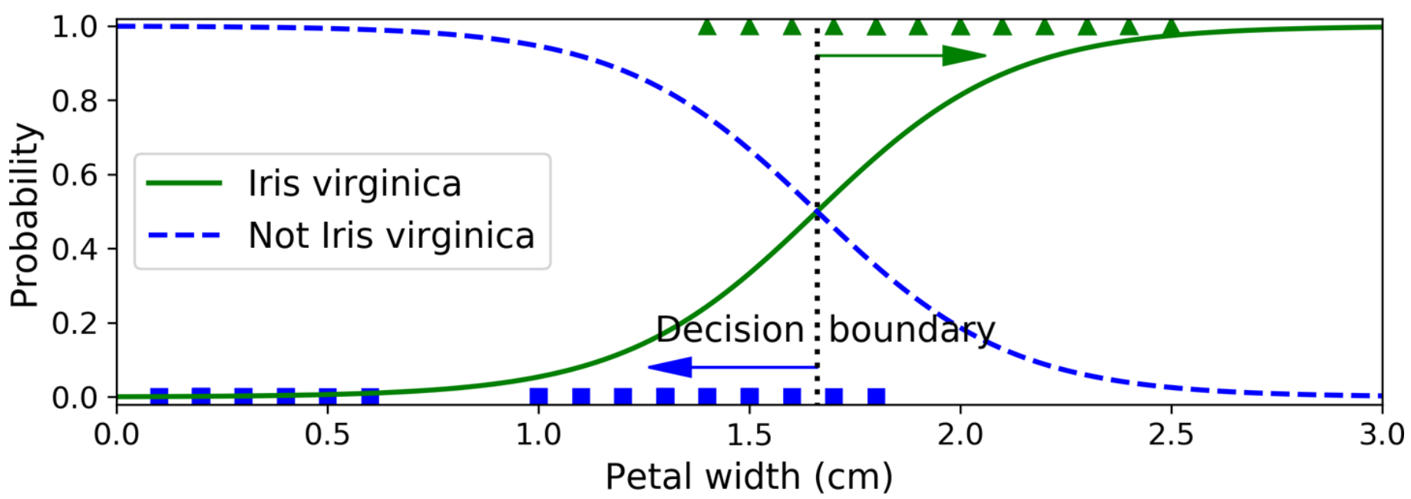
Logistic Regression Logistic Regression in Python
Let’s look at the model’s estimated probabilities for flowers with petal widths varying from 0 cm to 3 cm:
The petal width of Iris virginica flowers ranges from 1.4 cm to 2.5 cm, while the other iris flowers range from 0.1 cm to 1.8 cm.
Notice that there is a bit of overlap. Above about 2 cm the classifier is highly confident that the flower is an Iris virginica while below 1 cm it is highly confident that it is not an Iris virginica. (Underfitting)
X_new = np.linspace(0, 3, 1000).reshape(-1, 1)
y_proba = log_reg.predict_proba(X_new)
plt.scatter(X, y, color='darkred')
plt.plot(X_new, y_proba[:, 1], "g-", label="Iris virginica")
plt.plot(X_new, y_proba[:, 0], "b--", label="Not Iris virginica")
plt.xlabel('Petal Width (cm)')
plt.ylabel('Probability')
plt.legend()

Slide 23
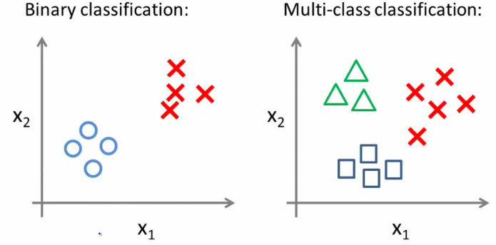
Multiclass Classification
Email foldering/tagging: Work, Friends, Family, Hobby
Medical diagrams: Not ill, Cold, Flu
Weather: Sunny, Cloudy, Rain, Snow
Given a dataset with three classes, how do we get a learning algorithm to work?
Use one vs. all classification make binary classification
work for multiclass classification

Slide 24
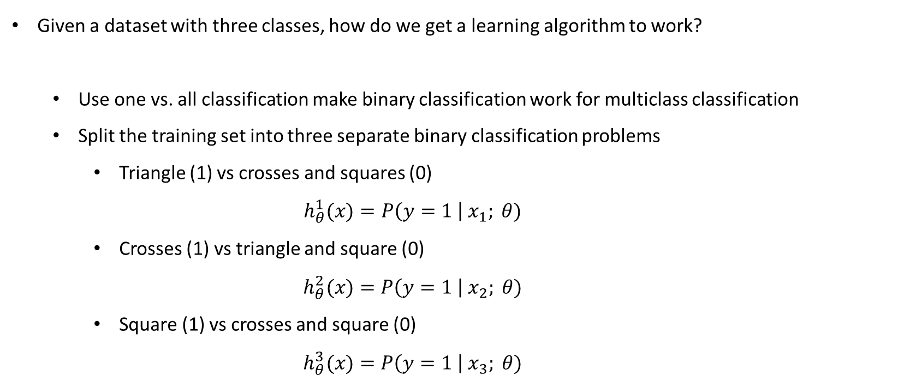
Multiclass Classification One-vs-All
Given a dataset with three classes, how do we get a learning algorithm to work?
Use one vs. all classification make binary classification work for multiclass classification
Split the training set into three separate binary classification problems
Triangle (1) vs crosses and squares (0)
$$h_{θ}^{1}(x)=P\left(y=1 \right| x_{1}; θ)$$
Crosses (1) vs triangle and square (0)
$$h_{θ}^{2}(x)=P\left(y=1 \right| x_{2}; θ)$$
Square (1) vs crosses and square (0)
$$h_{θ}^{3}(x)=P\left(y=1 \right| x_{3}; θ)$$

Slide 25
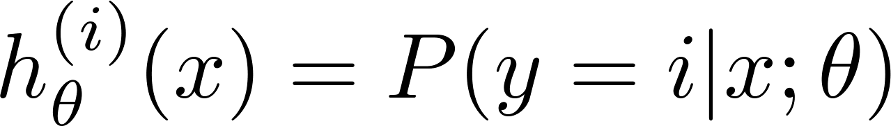
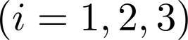
Multiclass Classification One-vs-All
x₂
x₁
x₂
x₂
x₁
x₁
Class 1:
Class 2:
Class 3:
x₂
x₁

Slide 26
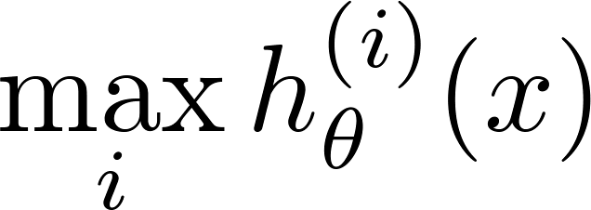
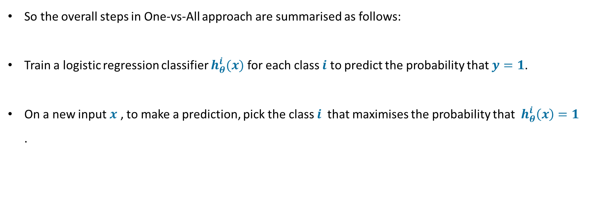
Multiclass Classification One-vs-All
So the overall steps in One-vs-All approach are summarised as follows:
Train a logistic regression classifier $h_{θ}^{i}(x)$ for each class $i$ to predict the probability that $y=1$.
On a new input $x$ , to make a prediction, pick the class $i$that maximises the probability that $h_{θ}^{i}\left(x\right)=1$ .

Slide 27
Spot Quiz 1
Suppose you want to classify pictures as outdoor/indoor and day-time/night-time. Which regression classifier should we use? Binary Logistic Regression or Multiclass Logistic Regression?

Slide 28
Multiclass Classification Logistic Regression in Python
Let’s build a classifier to detect the Iris virginica, setosa and versicolor types based on the petal width, petal length, sepal width and petal length features.
First load the data:
Split the data into 80% training and 20% testing
Now train a Logistic Regression model:
import numpy as np
import matplotlib.pyplot as plt
from sklearn import datasets
from sklearn.metrics import classification_report
from sklearn.metrics import accuracy_score
iris = datasets.load_iris()
X = iris.data[:, :4] # it takes the first four columns (4 features).
y = iris.target
#Split the data into 80% training and 20% testing.
from sklearn.model_selection import train_test_split
X_train, X_test, y_train, y_test = train_test_split(X, y, test_size=0.2, random_state=42)
from sklearn.linear_model import LogisticRegression
log_reg = LogisticRegression(C=1e5)
log_reg.fit(X_train, y_train)

Slide 29
Multiclass Classification Logistic Regression in Python
Test the model:
Accuracy
predictions = log_reg.predict(X_test)
print(predictions)
#Check precision, recall, f1-score
print( classification_report(y_test, predictions) )
print( accuracy_score(y_test, predictions))

Slide 30
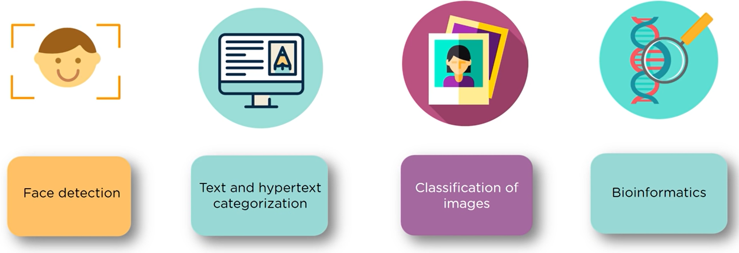
Support Vector Machine (SVM)
Applications:

Slide 31
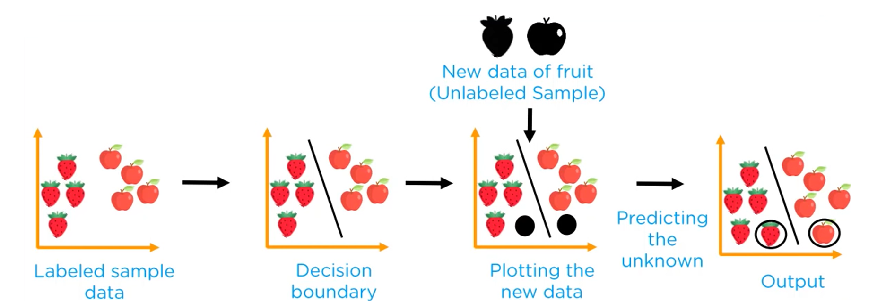
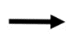
Support Vector Machine (SVM)
It is one of the most popular models in Machine Learning.
SVM performs linear or nonlinear classification, regression, and even outlier detection.
SVMs are particularly well suited for classification of complex small- or medium-sized datasets.
SVM

Slide 32
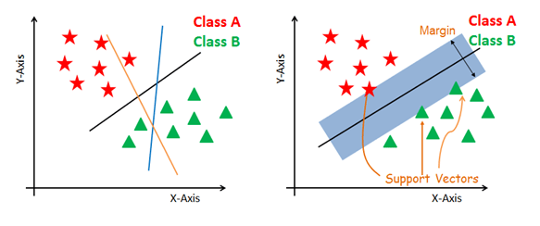
Support Vector Machine (SVM)
The best possible line is the one with the maximum space that separates the 2 classes

Slide 33
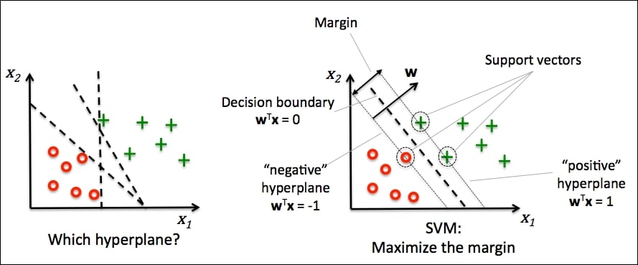
Support Vector Machine (SVM)
Support Vector: The extreme points in the dataset.
Hyperplane: Has the maximum vertical distance to the support vector of any class.
Margin: The sum of the hyperplane distance to the support vectors.

Slide 34

Support Vector Machine (SVM)
SVM can be of two types:
Linear SVM: Linear SVM is used for linearly separable data.
Non-linear SVM: Non-Linear SVM is used for non-linearly separated data.

Slide 35
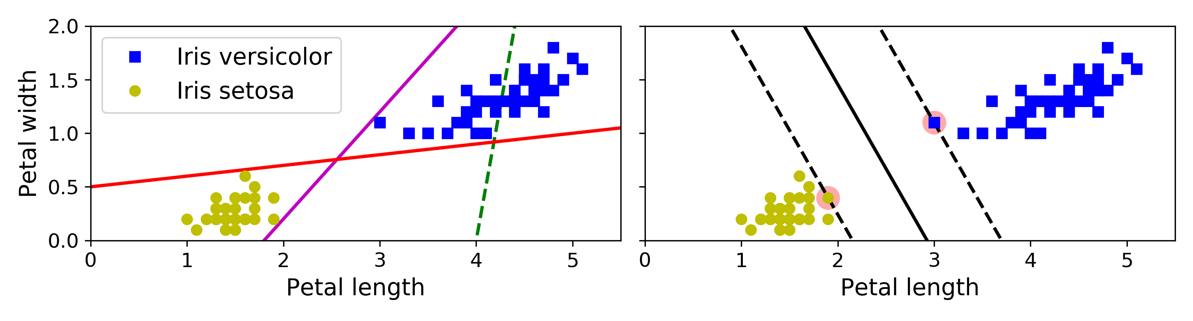
Support Vector Machine (SVM) Linear SVM Classification
Remember the iris dataset that was introduced at the Logistic Regression section.
The two classes can be separated easily with a straight line (they are linearly separable).
The plot shows the decision boundaries of three possible linear classifiers.
The dashed line separator is so bad.
The other two models work perfectly on this training set, but their decision boundaries come so close to the instances that these models will probably not perform as well on new instances.

Slide 36
Support Vector Machine (SVM) Linear SVM Classification
In contrast, the solid line in the plot on the right is the decision boundary of an SVM classifier;
This line not only separates the two classes but also stays as far away from the closest training instances as possible.
SVM fits the widest possible street between the classes. This is called large margin classification.
The decision boundaries are fully “supported” by the instances located on the edge of the street.
These instances are called the support vectors (Red circles in the figure).

Slide 37
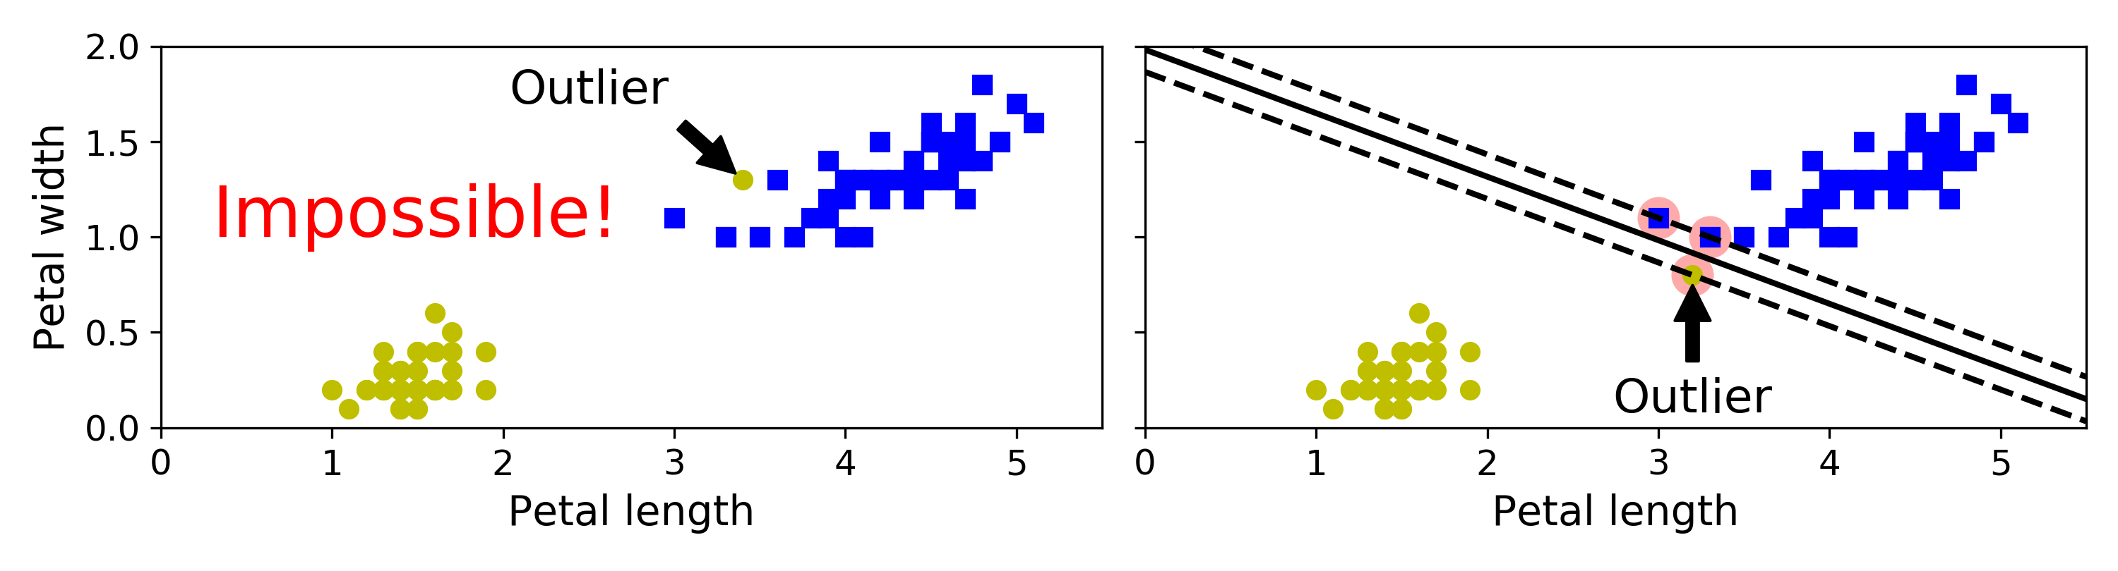
Support Vector Machine (SVM) Linear SVM Classification
Hard Margin SVM Classification:
If we strictly impose that all instances must be off the street and on the right side, this is called hard margin classification.
There are two main issues with hard margin classification.
It only works if the data is linearly separable.
It is sensitive to outliers.

Slide 38
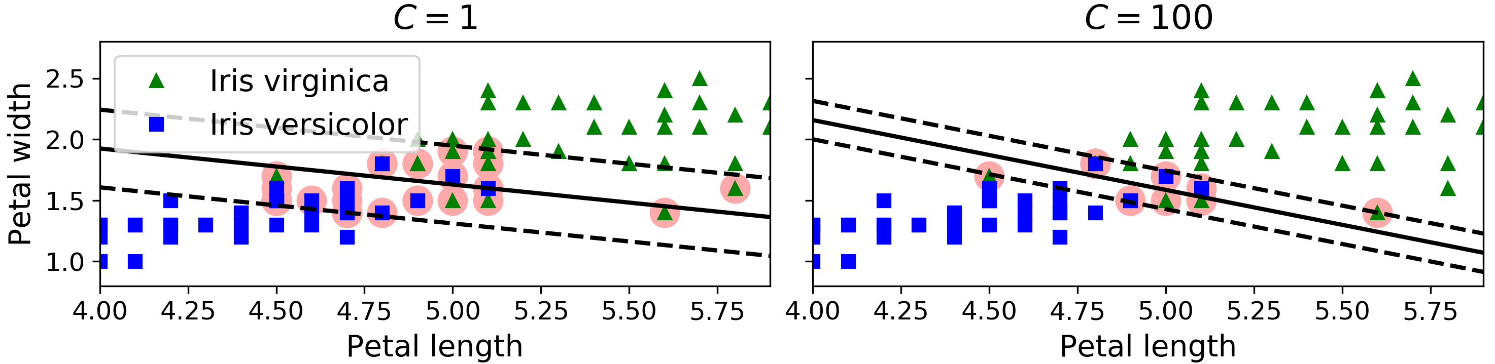
Support Vector Machine (SVM) Linear SVM Classification
Soft Margin SVM Classification:
Instead we can use a more flexible model.
The objective is to find a good balance between keeping the street as large as possible and limiting the margin violations (i.e., instances that end up in the middle of the street or even on the wrong side).
When creating an SVM model using Scikit-Learn, we can specify a number of hyperparameters.
C is one of those hyperparameters.

Slide 39
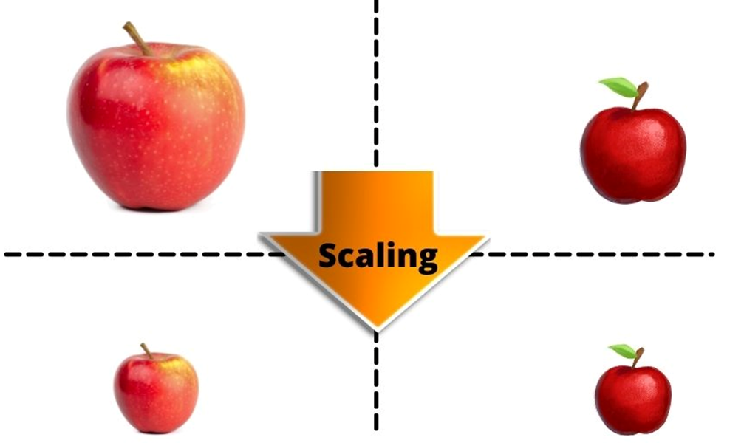
Support Vector Machine (SVM) Linear SVM Classification Feature Scaling
Feature Scaling is a technique to standardize the independent features present in the data in a fixed range.
It is performed during the data pre-processing to handle highly varying magnitudes or values or units.
If feature scaling is not done, then a machine learning algorithm tends to weigh greater values, higher and consider smaller values as the lower values, regardless of the unit of the values.
Example with numbers

Slide 40
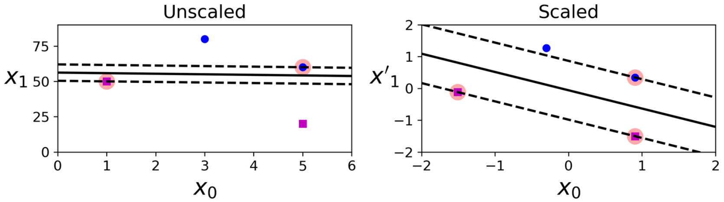
Support Vector Machine (SVM) Linear SVM Classification
SVMs are sensitive to the feature scales,
In the left plot, the vertical scale is much larger than the horizontal scale, so the widest possible street is close to horizontal.
After feature scaling (e.g., using Scikit-Learn’s StandardScaler), the decision boundary in the right plot looks much better.

Slide 41
Linear SVM Classification in Python
Let’s Try Linear SVM in Python

Slide 42
Support Vector Machine (SVM) Linear SVM Classification Sklearn
The following Scikit-Learn code loads the iris dataset, scales the features, and then trains a linear SVM model (using the LinearSVC class with C=1 and the hinge cost function) to detect Iris virginica flowers:
Unlike Logistic Regression classifiers, SVM classifiers do not output probabilities for each class.
import numpy as np
from sklearn import datasets
from sklearn.pipeline import Pipeline
from sklearn.preprocessing import StandardScaler
from sklearn.svm import LinearSVC
iris = datasets.load_iris()
X = iris["data"][:, (2, 3)] # petal length, petal width
y = (iris["target"] == 2).astype(np.float64) # Iris virginica
svm_clf = Pipeline([
("scaler", StandardScaler()),
("linear_svc", LinearSVC(C=1, loss="hinge", random_state=42)),
])
svm_clf.fit(X, y)

Slide 43
Support Vector Machine (SVM) Linear SVM Classification Sklearn
Plotting the decision boundary:
Creating the Unscaled model:
Convert to unscaled parameters:
Find support vectors (LinearSVC does not do this automatically)
scaler = StandardScaler()
svm_clf1 = LinearSVC(C=1, loss="hinge", random_state=42)
scaled_svm_clf1 = Pipeline([
("scaler", scaler),
("linear_svc", svm_clf1),
])
scaled_svm_clf1.fit(X, y)
b1 = svm_clf1.decision_function([-scaler.mean_ / scaler.scale_])
w1 = svm_clf1.coef_[0] / scaler.scale_
svm_clf1.intercept_ = np.array([b1])
svm_clf1.coef_ = np.array([w1])
t = y * 2 - 1
support_vectors_idx1 = (t * (X.dot(w1) + b1) < 1).ravel()
svm_clf1.support_vectors_ = X[support_vectors_idx1]

Slide 44
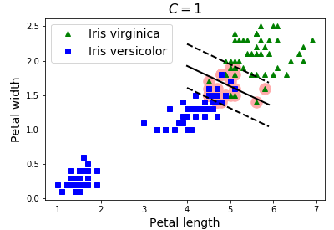
Support Vector Machine (SVM) Linear SVM Classification Sklearn
Defining a function for plotting the SVM model:
Plotting the SVM Model decision boundaries:
import matplotlib.pyplot as plt
plt.plot(X[:, 0][y==1], X[:, 1][y==1], "g^", label="Iris virginica")
plt.plot(X[:, 0][y==0], X[:, 1][y==0], "bs", label="Iris versicolor")
plot_svc_decision_boundary(svm_clf1, 4, 5.9)
plt.xlabel("Petal length", fontsize=14)
plt.ylabel("Petal width", fontsize=14)
plt.legend(loc="upper left", fontsize=14)
plt.title("$C = {}$".format(svm_clf1.C), fontsize=16)
def plot_svc_decision_boundary(svm_clf, xmin, xmax):
w = svm_clf.coef_[0]
b = svm_clf.intercept_[0]
# At the decision boundary, w0*x0 + w1*x1 + b = 0
# => x1 = -w0/w1 * x0 - b/w1
x0 = np.linspace(xmin, xmax, 200)
decision_boundary = -w[0]/w[1] * x0 - b/w[1]
margin = 1/w[1]
gutter_up = decision_boundary + margin
gutter_down = decision_boundary - margin
svs = svm_clf.support_vectors_
plt.scatter(svs[:, 0], svs[:, 1], s=180, facecolors='#FFAAAA')
plt.plot(x0, decision_boundary, "k-", linewidth=2)
plt.plot(x0, gutter_up, "k--", linewidth=2)
plt.plot(x0, gutter_down, "k--", linewidth=2)

Slide 45
Support Vector Machine (SVM) Linear SVM Classification Sklearn
The Linear SVM on the Iris dataset:
import numpy as np
from sklearn import datasets
from sklearn.metrics import classification_report
from sklearn.metrics import accuracy_score
from sklearn.pipeline import Pipeline
from sklearn.preprocessing import StandardScaler
from sklearn.svm import LinearSVC
iris = datasets.load_iris()
X = iris.data[:, :4] # it takes the first four columns (4 features).
y = iris.target
#Split the data into 80% training and 20% testing.
from sklearn.model_selection import train_test_split
X_train, X_test, y_train, y_test = train_test_split(X, y, test_size=0.2, random_state=42)
svm_clf = Pipeline([
("scaler", StandardScaler()),
("linear_svc", LinearSVC(C=1, loss="hinge", random_state=42, max_iter=1200000)),
])
svm_clf.fit(X_train, y_train)

Slide 46
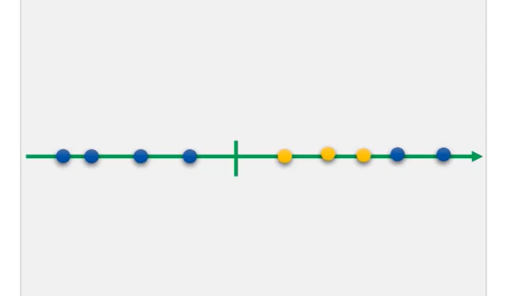
Support Vector Machine (SVM) Nonlinear SVM Classification
What if data looks like this?
How do we plot the hyperplane?

Slide 47
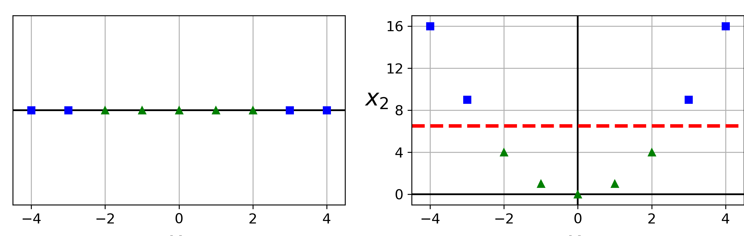
Support Vector Machine (SVM) Nonlinear SVM Classification
Although linear SVM classifiers are efficient and work surprisingly well in many cases, many datasets are not even close to being linearly separable.
One approach to handling nonlinear datasets is to add more features, such as polynomial features
In some cases this can result in a linearly separable dataset.

Slide 48
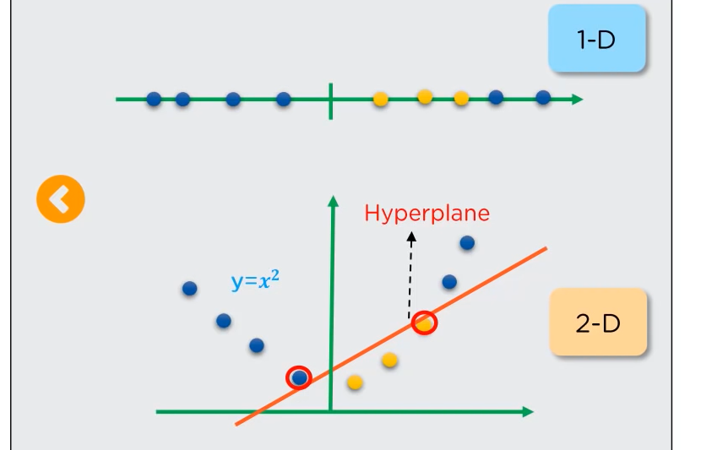
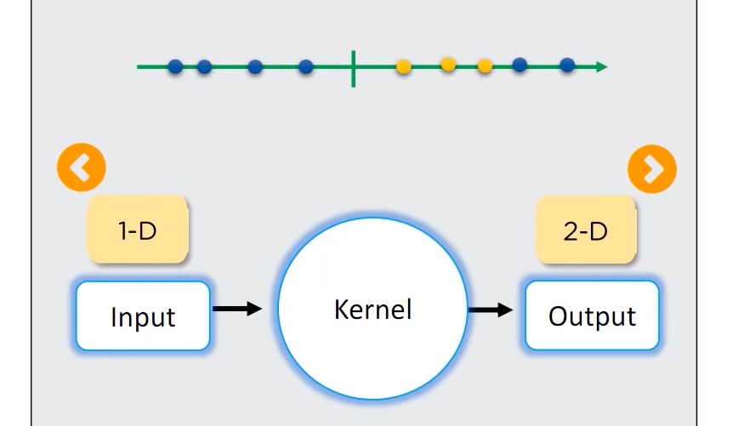
Support Vector Machine (SVM) Nonlinear SVM Classification
Kernels are used to transform the view from a 1-D view to a 2-D view.

Slide 49
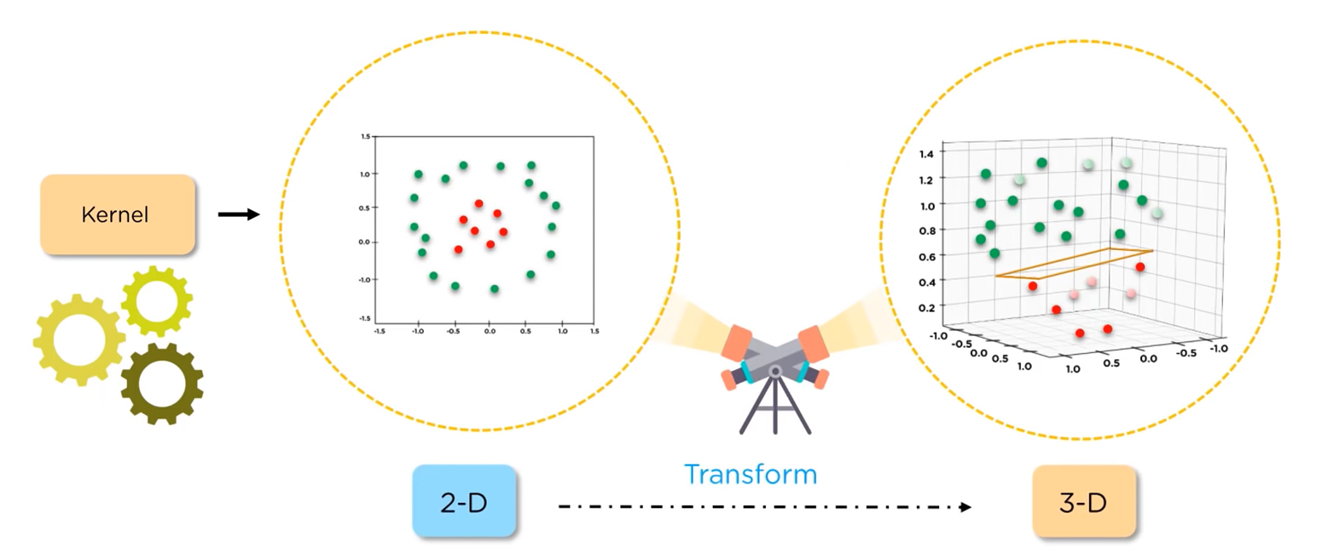
Support Vector Machine (SVM) Nonlinear SVM Classification
An example of using kernel to transform the view from a 2-D view to 3-D.

Slide 50
Support Vector Machine (SVM) Nonlinear SVM Classification Sklearn Polynomial Kernel
Adding polynomial features is simple to implement and can work great with all sorts of Machine Learning algorithms (not just SVMs). But:
At a low polynomial degree, it cannot deal with complex datasets.
At a high polynomial degree, it creates a huge number of features, therefore, too slow.
Fortunately, with SVMs we can use a technique called the kernel trick.
The kernel trick makes it possible to get the same result as if you had added many polynomial features, without actually having to add them.
So you don’t actually add any features.
More information about Polynomial Kernel: https://www.youtube.com/watch?v=Toet3EiSFcM

Slide 51
Support Vector Machine (SVM) Nonlinear SVM Classification Sklearn Radial Basis Function (RBF) Kernel
Radial Basis Function kernels are one of the most widely used kernels.
RBF kernel is used in SVM to deal with overlapping datapoints.
Because Radial kernel finds SVM in infinite dimensions, it is impossible to visualise what it does.
RBF kernel classify the new points by finding the nearest points in the training sets.
The closer the points are, the more influence they have on the new points.
The RBF kernel function for two points X₁ and X₂ computes the similarity or how close they are to each other.
More information about Radial Basis Function (RBF): https://www.youtube.com/watch?v=Qc5IyLW_hns

Slide 52
Non-Linear SVM in Python
Let’s Try Non-Linear SVM in Python

Slide 53
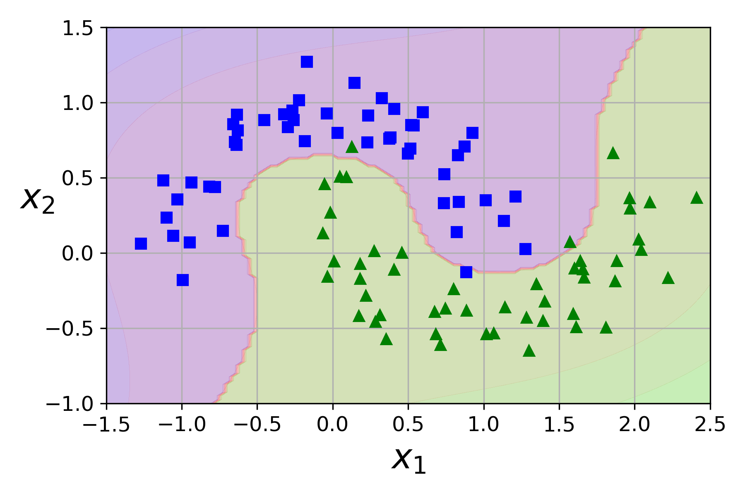
Support Vector Machine (SVM) Nonlinear SVM Classification Sklearn
To implement this idea using Scikit-Learn,
Create a Pipeline containing a PolynomialFeatures transformer
Then a StandardScaler and a LinearSVC.
Let’s test this on the moons dataset:
This is a toy dataset for binary classification in which the data points are shaped as two interleaving half circles. You can generate this dataset using the make_moons() function:

Slide 54
Support Vector Machine (SVM) Nonlinear SVM Classification Sklearn
Importing the moon dataset and creating and fitting the nonlinear SVM model:
Plotting the SVM classification result:
def plot_predictions(clf, axes):
x0s = np.linspace(axes[0], axes[1], 100)
x1s = np.linspace(axes[2], axes[3], 100)
x0, x1 = np.meshgrid(x0s, x1s)
X = np.c_[x0.ravel(), x1.ravel()]
y_pred = clf.predict(X).reshape(x0.shape)
y_decision = clf.decision_function(X).reshape(x0.shape)
plt.contourf(x0, x1, y_pred, cmap=plt.cm.brg, alpha=0.2)
plt.contourf(x0, x1, y_decision, cmap=plt.cm.brg, alpha=0.1)
def plot_dataset(X, y, axes):
plt.plot(X[:, 0][y==0], X[:, 1][y==0], "bs")
plt.plot(X[:, 0][y==1], X[:, 1][y==1], "g^")
plt.axis(axes)
plt.grid(True, which='both')
plt.xlabel(r"$x_1$", fontsize=20)
plt.ylabel(r"$x_2$", fontsize=20, rotation=0)
plot_predictions(polynomial_svm_clf, [-1.5, 2.5, -1, 1.5])
plot_dataset(X, y, [-1.5, 2.5, -1, 1.5])
plt.show()
from sklearn.datasets import make_moons
from sklearn.pipeline import Pipeline
from sklearn.preprocessing import PolynomialFeatures
X, y = make_moons(n_samples=100, noise=0.15, random_state=42)
polynomial_svm_clf = Pipeline([
("poly_features", PolynomialFeatures(degree=3)),
("scaler", StandardScaler()),
("svm_clf", LinearSVC(C=10, loss="hinge", random_state=42))
])
polynomial_svm_clf.fit(X, y)

Slide 55
Support Vector Machine (SVM) Nonlinear SVM Classification Sklearn Polynomial Kernel Sklearn
Let’s test the kernel trick on the moons dataset:
This code trains an SVM classifier using a third-degree polynomial kernel:
This code trains an SVM classifier using a 10th-degree polynomial kernel:
from sklearn.svm import SVC
poly_kernel_svm_clf = Pipeline([
("scaler", StandardScaler()),
("svm_clf", SVC(kernel="poly", degree=3, coef0=1, C=5))
])
poly_kernel_svm_clf.fit(X, y)
poly100_kernel_svm_clf = Pipeline([
("scaler", StandardScaler()),
("svm_clf", SVC(kernel="poly", degree=10, coef0=100, C=5))
])
poly100_kernel_svm_clf.fit(X, y)

Slide 56
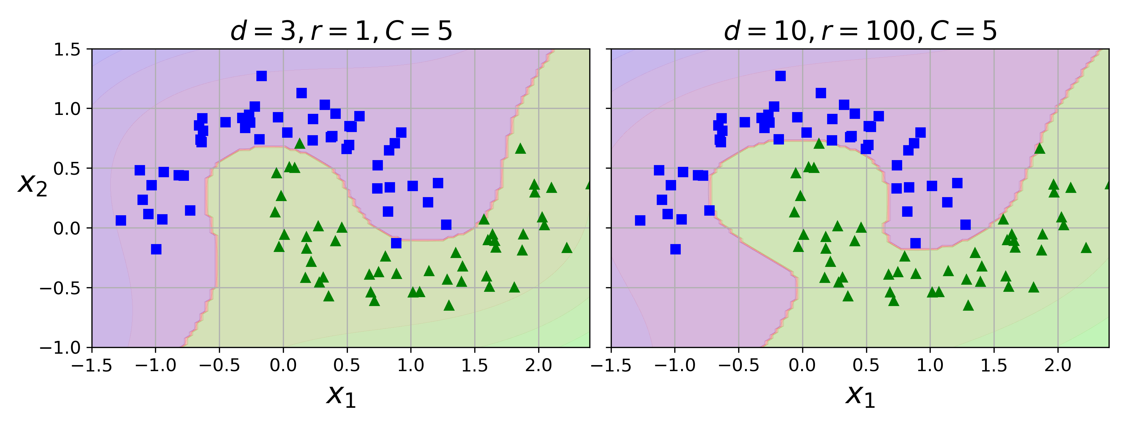
Support Vector Machine (SVM) Nonlinear SVM Classification Sklearn Polynomial Kernel Sklearn
Plotting the model:
If your model is overfitting, you might want to reduce the polynomial degree.
If it is underfitting, you can try increasing it.
The hyperparameter coef0 controls how much the model is influenced by high-degree polynomials versus low-degree polynomials.
fig, axes = plt.subplots(ncols=2, figsize=(10.5, 4), sharey=True)
plt.sca(axes[0])
plot_predictions(poly_kernel_svm_clf, [-1.5, 2.45, -1, 1.5])
plot_dataset(X, y, [-1.5, 2.4, -1, 1.5])
plt.title(r"$d=3, r=1, C=5$", fontsize=18)
plt.sca(axes[1])
plot_predictions(poly100_kernel_svm_clf, [-1.5, 2.45, -1, 1.5])
plot_dataset(X, y, [-1.5, 2.4, -1, 1.5])
plt.title(r"$d=10, r=100, C=5$", fontsize=18)
plt.ylabel("")
plt.show()

Slide 57
Support Vector Machine (SVM) Linear SVM Classification Sklearn
The NonLinear SVM on the Iris dataset:
import numpy as np
from sklearn import datasets
from sklearn.metrics import classification_report
from sklearn.metrics import accuracy_score
from sklearn.pipeline import Pipeline
from sklearn.preprocessing import StandardScaler
from sklearn.svm import LinearSVC
iris = datasets.load_iris()
X = iris.data[:, :4] # it takes the first four columns (4 features).
y = iris.target
#Split the data into 80% training and 20% testing.
from sklearn.model_selection import train_test_split
X_train, X_test, y_train, y_test = train_test_split(X, y, test_size=0.2, random_state=42)
poly100_kernel_svm_clf = Pipeline([
("scaler", StandardScaler()),
("svm_clf", SVC(kernel="poly", degree=10, coef0=100, C=5))
])
poly100_kernel_svm_clf.fit(X_train, y_train)
predictions = poly100_kernel_svm_clf.predict(X_test)
print(predictions)
#Check precision, recall, f1-score
print( classification_report(y_test, predictions) )
print( accuracy_score(y_test, predictions))

Slide 58
Any Questions?

